Slide 1
Medial EarlySign – AlgoMedical Framework intro
September 2023

Slide 2

Challenges with AI On Medical Data
Data is temporal, yet highly irregular
Need to create features that capture dynamics
Some highly sparsed categorical signals
Diagnoses, Procedures, Medications (claims and HER)
100k and more dimensions
Data comprises of different types of signals, units, distributions
Data not collected in controlled environment –
It is partial and extremely noisy
Biased
Rich in spurious patterns that make generalization difficult
Sensitive to changes in health care policies
Coming from different sources and collected and reported inconsistently
Populations and data vary

Slide 3

Imaging
Medical records

Slide 4
Working the Data by Examples
Challenges and Biases

Slide 5
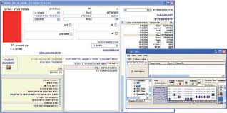


Not Understanding The Clinical Context
Example: A model trying to predict pre-eclampsia
Team developed a model and saw interesting results
Trying to analyze the results they saw that one of the significant signals came from Magnesium
Problem ?
Wrong Time Stamp for re-eclampsia
Solution: Clipping input to meaningful date
“For women with eclampsia, the administration of parenteral magnesium sulfate is recommended”
The American College of Obstetricians and Gynecologists Task Force on Hypertension in Pregnancy 2013

Slide 6
Challenges in Sampling
2013
2014
2015
2016
2017
2018
Improved recording of target condition
Cases
Controls
Changes in policies or calibration of machines
Classifiers identify time and use it as a feature
Solution : Match samples by year (or other parameters)
Matching can also be used in learning and analysis

Slide 7
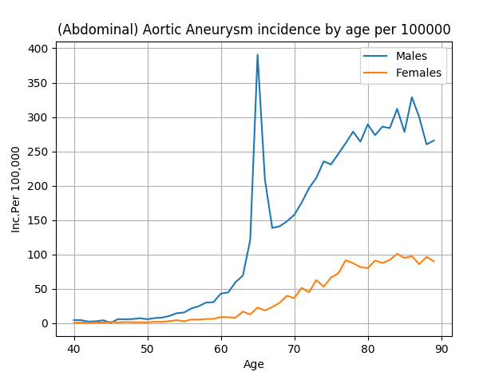
AAA Incidence per age and gender

Slide 8
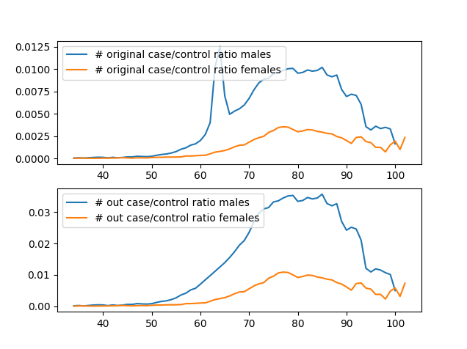
AAA Incidence per age and gender - fix

Slide 9
Peeking into the future
Example: Model to identify progression of normoglycemia to prediabetes
Work accepted to peer reviewed publication (by big pharma)
Good Results
Patients were considered to have transitioned to prediabetes on the earliest date corresponding to multiple (≥2) consecutive glucose measures qualifying as prediabetes (110 <= FG <125 , 5.7% <= A1C < 6.5%)
Problem [s] ?
Now, there are controls with a pre-diabetic value , that is “Normal”
The model could know as FACT that the next FG test in not in the prediabetic range. Artifact of cohort design that doesn’t happen in real world
Leakage of future information at T₀ !!! , problematic for real world use*
This is a typical peeking into the future error
Case
125
110
Time
T₀
T₁
Control
125
110
Time
T₀
T₁
^{* -} At T₀ , it is known that the measurement is not significant for pre-diabetes although it would really be determined only at T₁

Slide 10
Analysis of Results
Fairness Methodology

Slide 11
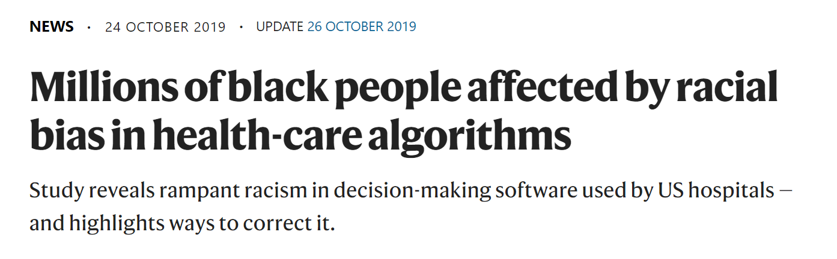
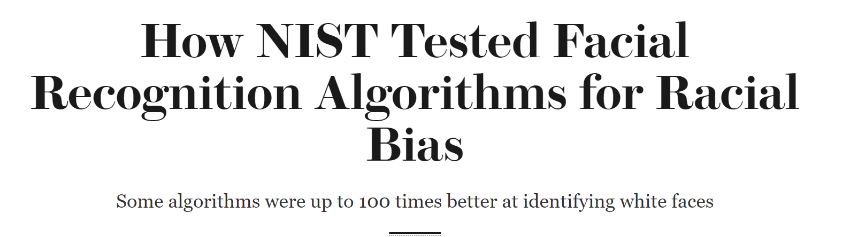
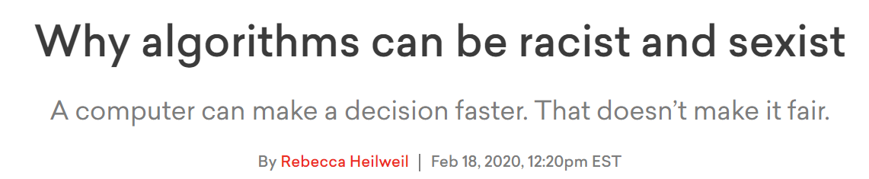
Discrimination via Algorithmic Bias
Notes:
“people who self-identified as black were generally assigned lower risk scores than equally sick white people. As a result, the black people were less likely to be referred to the programmes that provide more-personalized care.”
The researchers found that the algorithm assigned risk scores to patients on the basis of total health-care costs accrued in one year.
black people had to be sicker than white people before being referred for additional help. Only 17.7% of patients that the algorithm assigned to receive extra care were black. The researchers calculate that the proportion would be 46.5% if the algorithm were unbiased.
…
He and his team collaborated with the company to find variables other than healthcare costs that could be used to calculate a person's medical needs, and repeated their analysis after tweaking the algorithm accordingly. They found that making these changes reduced bias by 84%.
From the news
https://www.nature.com/articles/d41586-019-03228-6,
https://www.scientificamerican.com/article/how-nist-tested-facial-recognition-algorithms-for-racial-bias/
Additional sources:
https://www.vox.com/recode/2020/2/18/21121286/algorithms-bias-discrimination-facial-recognition-transparency
https://healthitanalytics.com/news/eliminating-racial-bias-in-algorithm-development

Slide 12
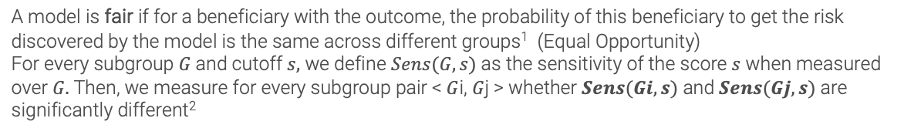
Example: Framework for Fairness/Bias Analysis
Define Subgroups
Model and Produce Scores
Measure Bias
Understand Root Cause
Mitigate The Bias
Analysis / Simulations
Subgroups Used: e.g., Age (19-45, 46-64, 65-74, 75+), Sex (M, F), County (MUA v. non-MUA, Rural v. non-Rural), Disability Status (Disabled v. non-disabled), Race (White, Black, Asian, Hispanic, etc.)
Calculate performance measurements: Partial AUCs, Sensitivities and Specificities at cut-offs, Incidence, etc., with confidence intervals for every subgroup
A model is fair if for a beneficiary with the outcome, the probability of this beneficiary to get the risk discovered by the model is the same across different groups¹ (Equal Opportunity)
For every subgroup $G$and cutoff $s,$ we define $Sens(G,s)$ as the sensitivity of the score $s$ when measured over $G.$Then, we measure for every subgroup pair < $G$i, $G$j > whether $Sens(Gi,s)$ and $Sens(Gj,s)$ are significantly different²
Acceptable Bias
Refine Cohort and Model
Unacceptable Bias³
Understand relation to other subgroups biases
Measure Bias
Explainability/ Feature Analysis
Measure Performance Change
Subgroup recalibration ⁴
Analysis , simulation and bootstrap tools for probability for outcome in multiple subgroups, cut-offs, time-windows alongside explainability factors and how well the subgroups are represented in training set
1 - "Equality of Opportunity in Supervised Learning" by Hardt et. al from 2016
2 - Sub group size may limit us in the ability to confidently identify significant differences
3 - There are cases in which the bias is inherent to the problem and the data that were collected
4 - Hebert-Johnson, U., Kim, M., Reingold, O. & Rothblum, G. (2018). Multicalibration: Calibration for the (Computationally-Identifiable) Masses. Proceedings of the 35th Int. Conf. on Machine Learning, in PMLR 80:1939-1948

Slide 13
“Analysis before deployment”

Slide 14
Validation before deployment
Set of reasonability tests:
Comparison of input signals to reference
Compare of score distributions
Estimation of performance (no outcome)
Sanity tests – coverage of known risk groups by the model
Explainability analysis on flagged patients – who is getting flagged
Semi-automated report

Slide 15
“Under The Hood”

Slide 16
New model development pipeline tools
Model construction: Modular, C++ libraries, python APIs
Data Preparation
Model Generation
MedRepositorty Data Model: Unified, efficient in time and memory
Validation & Analysis
Exporting
Datasets
Importing, Organization, Normalization, Ontologies
Cohort Preparation
Selecting population, Sampling, Labeling
Repository Processors
Outliers, Enrichment
Feature Generators
Moments, Trends, Embedding, Encoders
Feature Processors
Imputation, Feature Selection
Predictors
Regression, Trees, Boosting, Neural-Nets
Post-Process
Recalibration, Interpretation
Validation
Performance analysis, Bootstrapping, multiple datasets
AlgoAnalyzer
Export as AlgoMarker
A pipeline to process raw longitudinal medical data into insights
Notes:
I’m not going to talk about all the details – just say it’s a pipeline for processing the data from “raw” data into a prediction and insights like explainability. We have tools to analyze performance and “debug”/validate this output process

Slide 17
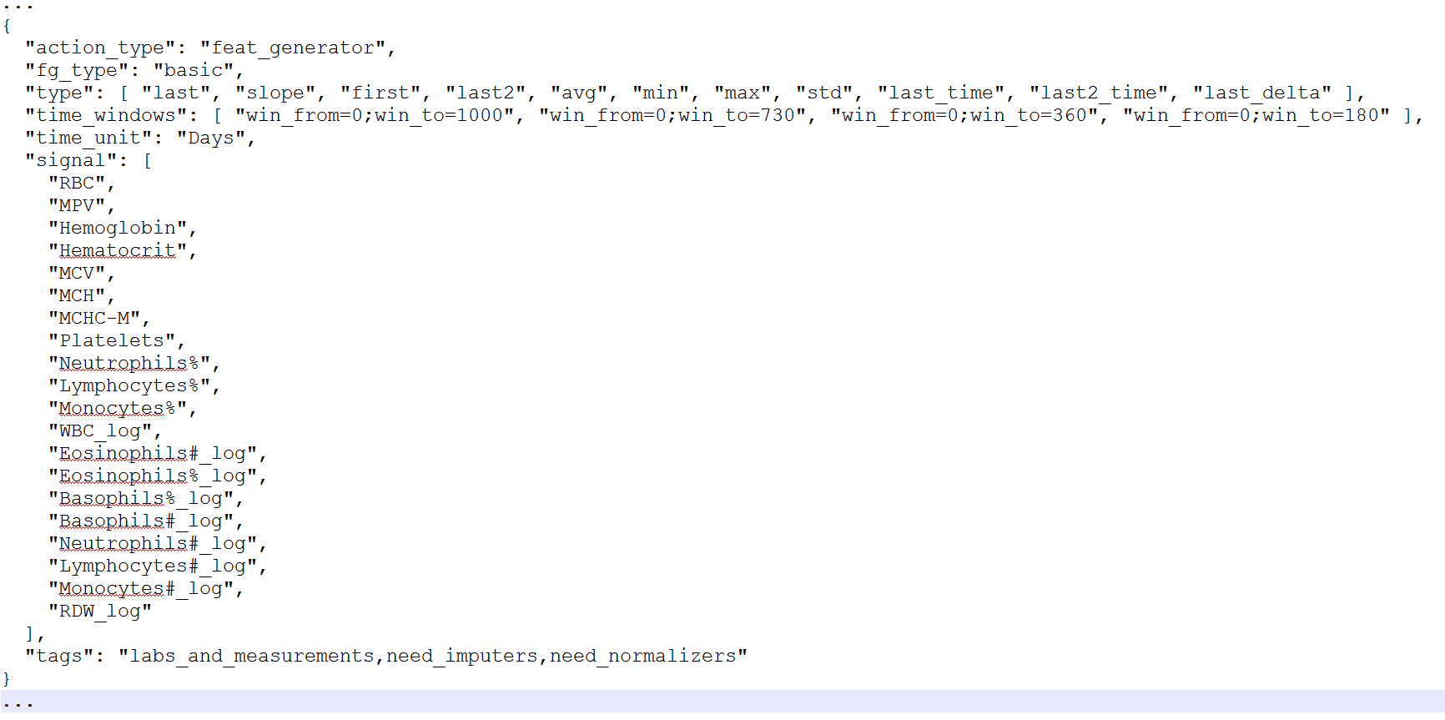
Example – Configuring Features For Use in Model
Feature Processors
Configuration block with simple feature components generator
Sparse Category
Moment and Trend
Time Operators
Encode-1..N
Impute-1..K
This block defines generation of : 11 (moment/trend operators) X 4 (time windows) X 20 (signals) = 880 different features
Signals
Core Signal
Virtual Signal 1..M
Library-K
Component
Component

Slide 18


The AlgoMedical Framework Environment
Can be installed on cloud or remote-sites
Automation Layer: Scripting and Coding
Loading Tools and Libraries
Model Definition Language
PerformanceValidation Tools and Libraries
Cohort Building
Training Tools and Libraries
Local Data
Performance Logs and Reports
Repository

Slide 20
Clinical Domains and Inputs We Use
Validated / Deployed
Candidate Model
Research
Inpatient/ER/ICU^{(*)}
Early Research
Claims
EHR (Outpatient)
Labs
Oncology
Cardiovascular
Chronic
Renal & Metabolic
Misc.
ColonFlag/LGI | AAA-Flag | Pre2D | Flu Complications
LungFlag | Diabetic CAD | Undiagnosed Diabetes | Blood Disorders
GastroFlag | Hypertensive CAD | Undiagnosed CKD | Anemia Root Cause
ProstateFlag | First CAD | CKD Fast Progressors | COPD Admissions
Asymptomatic Hematuria | A. Fib anticoagulation | Diabetic CKD | HF Admissions
 | Aortic Stenosis Deter. | Hypertensive CKD | CABG Admissions
 |  | CKD Complications | Re/admissions
 |  | CKD to ERSD
(*) Inpatient algorithms not listed

Slide 21
Interests
Broaden collaboration to additional indications of interest
Enrich the AlgoSuite portfolio , Value-add to additional Patient Journeys
From EarlySign roadmap
From Roche’s understanding of the market
Longer term thinking on leveraging mutual assets – R&D
Combine real world with new/novel biological inputs

Slide 22
Beyond EHR & Standard Labs

Slide 23
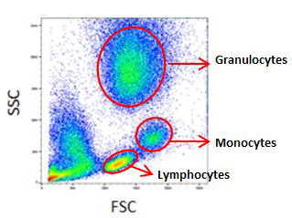
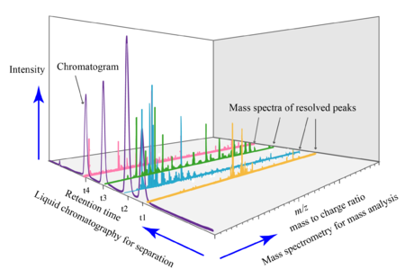
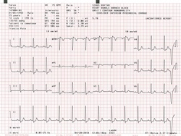
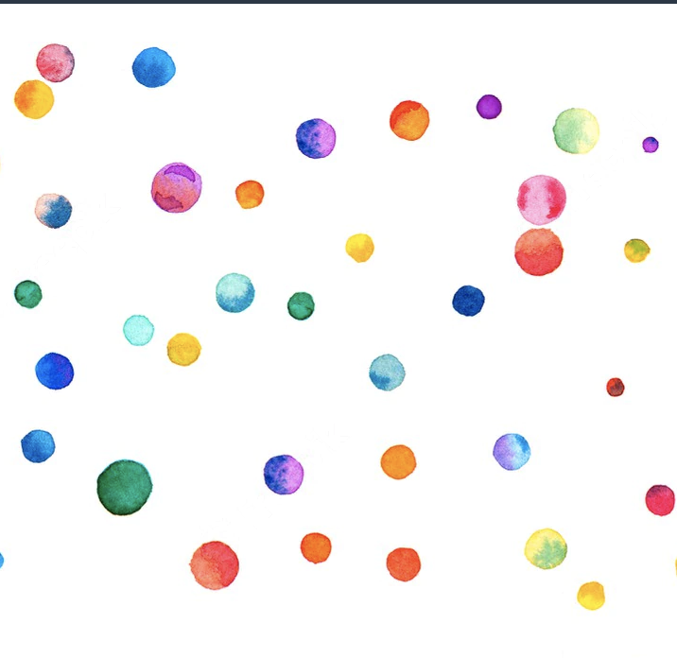
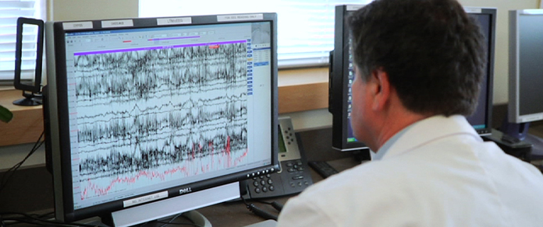
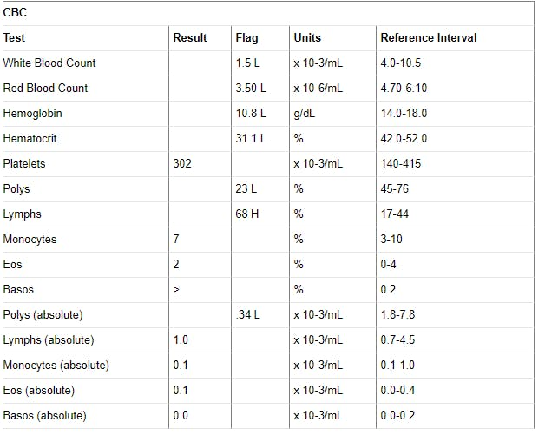

Biological Inputs could be …
Losing data often means losing potential insights!
… Siloed and Contextless markers
…transformed today to simple metrics or annotations
…too complex to utilize
…or require expert human interpretation

Slide 24
Clinical Domains and Inputs We Use
Validated / Deployed
Continuous Signals Annotated Imaging
Candidate Model
Novel/Proprietary Biomarkers
Research
Inpatient/ER/ICU^{(*)}
Early Research
Claims
EHR (Outpatient)
Labs
Oncology
Cardiovascular
Chronic
Renal & Metabolic
Misc.
+
ColonFlag/LGI | AAA-Flag | Pre2D | Flu Complications
LungFlag | Diabetic CAD | Undiagnosed Diabetes | Blood Disorders
GastroFlag | Hypertensive CAD | Undiagnosed CKD | Anemia Root Cause
ProstateFlag | First CAD | CKD Fast Progressors | COPD Admissions
Asymptomatic Hematuria | A. Fib anticoagulation | Diabetic CKD | HF Admissions
 | Aortic Stenosis Deter. | Hypertensive CKD | CABG Admissions
 |  | CKD Complications | Re/admissions
 |  | CKD to ERSD
+
+
(*) Inpatient algorithms not listed

Slide 26
Selection Bias / Leak
- WBC
- WBC used as Dx
Example: Model to identify risk for Lung Cancer
Case Control Design – 5 years of history
Cases 5 years from Dx Date – site decision
Controls 5 years from index date (starting Jul 1st on Index year) – site decision
Good Results
Work accepted to peer reviewed publication
Problem ?
To avoid bias related to month of July 1st , WBC was randomly selected for year from Index-date
Introduction of a new bias - Different length of history for cases and controls
Subtle, but the “Machine Learning Beast” lives off such hints
- Cancer Dx
Case
Dx
Dx-5Y
Control-k
1-Jul-YY
Dx
1-Jul-YY-5
Control-n
1-Jul-YY
Dx
1-Jul-YY-5
Notes:
Reverse slides

Slide 27
Understanding the Data
Examples – Practices and Tools
(Labeling, Peeking, Normalization, … )

Slide 28


Labeling – The Tip of the Iceberg
Clinical / Informatics Expert
Data Scientist

Slide 29
Learning the book from it’s cover – formatting biases
Example: A model to predict colorectal cancer using blood counts
Team developed a model and saw extremely good results (high AUC)
Analysis shown Basophiles have significant predictive power
There was no evident biological explanation - is this a new scientific finding ?!
Problem ?
Basophiles with two decimal digit results came from regional labs
Labs were located in northern region
Some populations in that region are much less compliant to screening
Colonoscopies in these populations have a higher cancer prevalence
colonoscopies with positive findings were enriched with two digit results
Basophils# | 12345 | 2008 | 0.0337 | 10^9/L
Basophils# | 12346 | 2008 | 0.1567 | 10^9/L
Basophils# | 12347 | 2001 | 0.0355 | 10^9/L
Basophils# | 12348 | 2011 | 0.04 | 10^9/L
Basophils# | 12349 | 2017 | 0.0557 | 10^9/L
Basophils# | 12350 | 2017 | 0.06 | 10^9/L
Basophils# | 12351 | 2008 | 0.0741 | 10^9/L
Basophils# | 12352 | 2011 | 0.0834 | 10^9/L
Basophils# | 12353 | 2008 | 0.0908 | 10^9/L
Basophils# | 12354 | 2007 | 0.1 | 10^9/L
Basophils# | 12355 | 2011 | 0.1124 | 10^9/L
Basophils# | 12356 | 2012 | 0.1297 | 10^9/L
Basophils# | 12357 | 2018 | 0.1367 | 10^9/L
Basophils# | 12358 | 2012 | 0.14 | 10^9/L
Basophils# | 12359 | 2006 | 0.1545 | 10^9/L
Basophils# | 12360 | 2017 | 0.16 | 10^9/L
Basophils# | 12361 | 2012 | 0.1745 | 10^9/L
Basophils# | 12362 | 2017 | 0.18 | 10^9/L
Basophils# | 12363 | 2008 | 0.19 | 10^9/L
Basophils# | 12364 | 2017 | 0.2974 | 10^9/L
Basophils# | 12365 | 2008 | 0.2143 | 10^9/L
Basophils# | 12366 | 2005 | 0.2268 | 10^9/L
Basophils# | 12367 | 2015 | 0.2369 | 10^9/L
Basophils# | 12368 | 2011 | 0.2456 | 10^9/L
Basophils# | 12369 | 2012 | 0.2578 | 10^9/L
Basophils# | 12370 | 2008 | 0.2678 | 10^9/L

Slide 30
Validation and Training Options - Concepts
Training
Validation and Testing
Pooled Data Pool Together Multiple Sets and Train on Unified Set
M_{p}
Validate same model on multiple sets and understand variabilities, retrain if necessary
M_{p}
M_{p}
M_{p}
M_{p}
S1
S3
VS1
VS2
VS3
VS_{n}
S2
Multiple Models Train Multiple Models Using Different Sets
M_{S1}
M_{S2}
M_{S3}
Validate all models on multiple sets and pick best performing
M_{S2}
M_{S2}
M_{S2}
M_{S2}
M_{S1}
M_{S3}
M_{S1}
M_{S3}
M_{S1}
M_{S3}
M_{S1}
M_{S3}
VS1
VS2
VS3
VS_{n}
S1
S2
S3
Ensemble Create an Ensemble of Multiple Models Trained on Different Sets
M_{e}
Validate same model on multiple sets and understand variabilities
[optimize ensemble]
M_{e}
M_{e}
M_{e}
M_{e}
M_{S1}
M_{S3}
M_{S1}
M_{S3}
M_{S1}
M_{S3}
M_{S1}
M_{S3}
M_{S1}
M_{S3}
M_{S2}
M_{S2}
M_{S2}
M_{S2}
M_{S2}
VS1
VS2
VS3
VS_{n}
S1
S2
S3

Slide 31
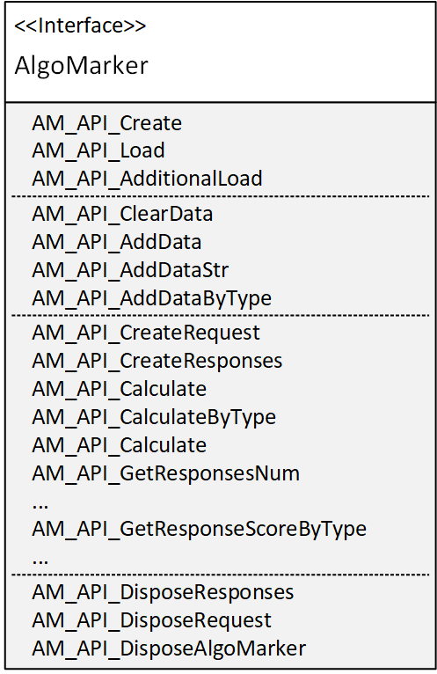
AlgoMarker Exported Library APIs
The AlgoMarker is a packaged module that uses in run-time EXACTLY the same components used for modelling
The AlgoMarker exposes an API to calculate scores and explainability:
Loading functions to initialiaze and load Algomarker from config file
Clear/Load data API to the virtual repository before calculating score - can load from json format or signal by signal using the API
Creating a request, response – access methods to those objects (including explainability)
Calling Calculate/CalculateByType - the main function to apply the model
Dispose and clear memory and objects

Slide 32
Model Development and Validation Workflow
Clinical Data Set
Load into data repository
Input: Target Population Selection and Target Event definitions for model (e.g., 12-month mortality)
Data Preparation¹
Cohort Selection
Registry Creation
Target event
Filtering
✓ Check Data ”Sanity”²
➔ Split to training and test sets
Feature Generation & Selection
Calibration and Explainability^{1,2}
Validation, Bias Analysis^{1,2}, [Simulation]
Modeling
1 – Study Design and proper labeling are critical to avoid artifacts, labeling biases and spurious signal
2 – Opportunity to identify data biases, shortages and leaks

Slide 33

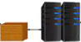
Topology
Deployment Options
Health System X1
Customer Computing Network
API Based communication
AlgoAnalyzer
Health System Y1
TSV
API
Input
File Based communication
Customer Computing Network
Results

Slide 34
Algorithmic Bias & Discrimination
What is Algorithmic Bias?
Systematic and repeatable errors in a computer system that create unfair outcomes, such as privileging one arbitrary group of users over others
Occurs because: algorithm sees less samples of a specific group, uses social determinants for prediction, mostly unknown factors
A real challenge to solve: looking for what’s hidden, low availability of sensitive data
Why should we care?
Responsibility – we impact people’s lives - make sure we are not introducing, perpetuating or amplifying discrimination
Provide better, more accurate solutions for everyone
Doing what’s right – be a leader in the AI revolution

Slide 35
A Framework for Clinical Modelling

Slide 36
Why Build Our Own Framework of Tools ?
R, MATLAB, SciKit-Learn, TensorFlow, Spark (and extensions), etc. – all offer partial solutions.
Need | Existing Platforms | Existing Platforms | Our Framework
Unified medical data model | ✓ | Several exist, no dominance | The Repository Structure, performance optimized
Configurable | ~ | Can adjust some parameters for models, but can’t configure the WHOLE process and need to do it in code | Scriptable and Configurable Model Language
Rich and varied features set | X | Need to rewrite for each project | Feature generation re-usable within framework and extendible
Analysis Tools | X | Very basic, Not matching medical analysis | Rich set of performance analysis tools
Efficient in memory and speed | ~ | Training runs OK, the rest is highly not efficient | Extremely efficient, low footprint, handles large data
All encompassing | X | Often start from matrix | Support the whole “production line”
Productization | X | Hard, need to write all the missing stuff | High starting point
Easy extension | X | Often hard to make changes. Users tend to stick to the available tools | Built to extend
Group effort | X | Each project development is independent of others | Reusable, sharable, extensions shared by whole team

Slide 37
Model Construction – overview
A unified toolset and language to define and work with ML projects.
Data Load Pipeline
Raw Data
Semi Automated
Repository
Unification (Loinc)
Unit translation
Resolution alignment
Ontology mapping
Modelling Pipeline
Optional
Modeling
& Testing
Modeling
& Testing
Export as AlgoMarker
Cohort Definition Pipeline
Bootstrap & simulation
Explainability
Fairness
Calibration
External validation
Cohort
Train/Test Lists
Configure:
Cleaning
Features
Selection
Imputations
Normalization
Model
Sampling
Filtering
Matching
Splitting

